Slide 1

Homework1
MAR 653 - Marketing Analytics
Date: 02/01/2021
Team:
Prasad Kulkarni
Sathish Rajendiran

Slide 2
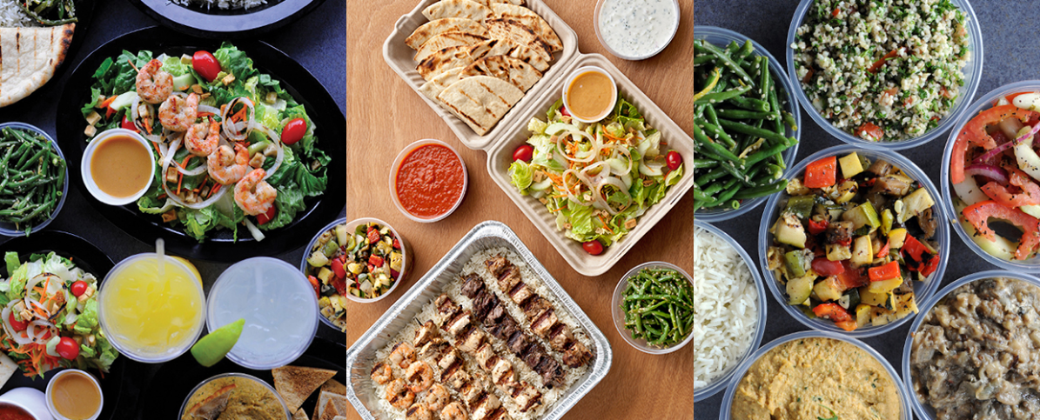

How do people choose a fast food restaurant to visit?
Case Study: Sticks Kebob Shop

Slide 3
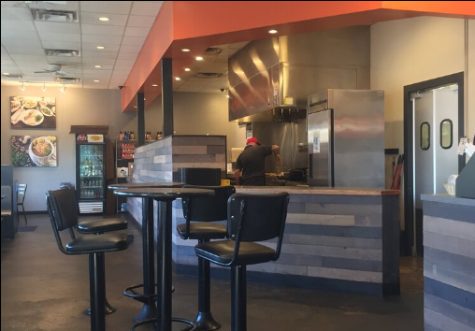
Who do you think are Sticks’ customers, and what are their motivations for visiting Sticks?
Question 1: I tend to Plan Things Carefully
QUESTION 2: I sometimes have trouble controlling my spending
Question 3: I think it is important to purchase products made locally
Question 4: I carefully consider the health benefits of what I eat
Sticks customers, per the survey, are people who have planned to visit Sticks, are not impulse buyers, and are concerned with the origin of the product or its health benefits.
The motivations for Sticks customers is they are visiting the establishment because it offers healthy option with locally made products at an affordable price.

Slide 4
What does the survey data tell us about differences between customers and noncustomers?
Based on the data the non-customers mirrored closely the stick customers when it came to whether they were planners or not. This was the same to whether they had trouble controlling spending. Non-customers tend to not have an issue controlling their spending
However, the results for whether they prefer locally made products and healthier options varied from the existing customers. It seems that the non-customers do not place the same value on these two as the current customers

Slide 5
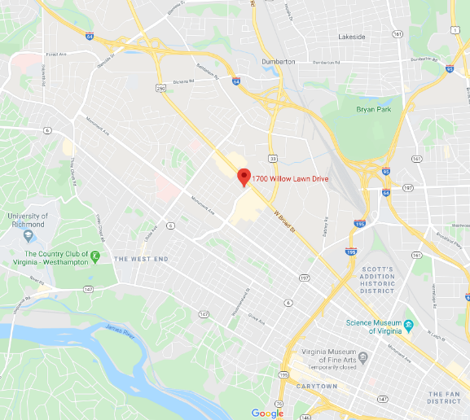
Location of Survey Focus
The Survey was focused on the Richmond area location which is just outside the city. It is located on W Broad St (State Hwy 250). This is also close to the Interstate IDL and the University of Richmond
Source: Google Maps, SticksKebobShop.com

Slide 6
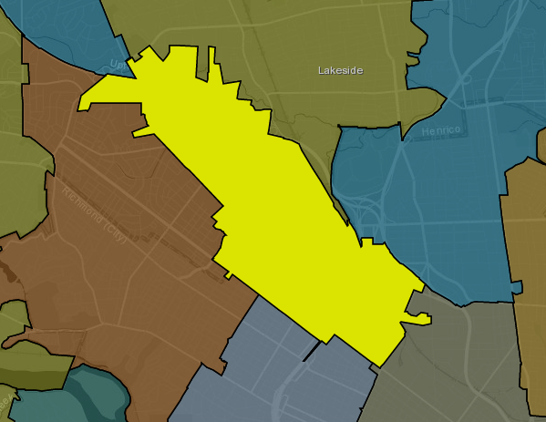
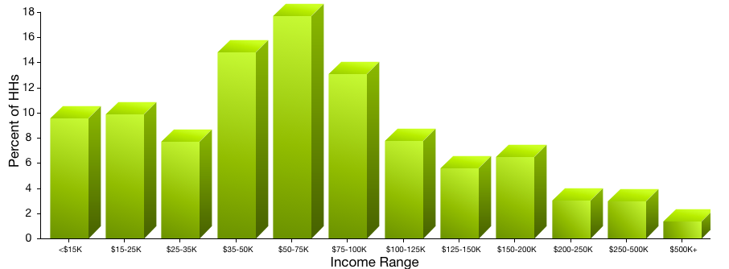
Zip Code Analysis
Upscale Younger Family Mix
Upward Bound are often upscale families boasting dual incomes, college degrees, and newer homes. Residents of Upward Bound are above average technology users who use computers and mobile devices for banking, TV and music streaming services, and online research.
Source: claritas.com, SticksKebobShop.com

Slide 7

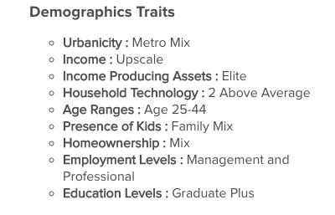
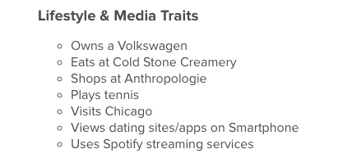


Sticks Customers – The Affluentials
Source: claritas.com

Slide 8
What survey questions would you use to identify the customer segments?
The following survey question were used for identifying customer segments
How Many times in a week do you –
Make Lunch at home,
Bring Lunch to work,
Buy Lunch at work,
Buy Lunch at Restaurant,
Skipped Lunch
What is your gender?
What is your age?
What is your approximate average annual household income?

Slide 9
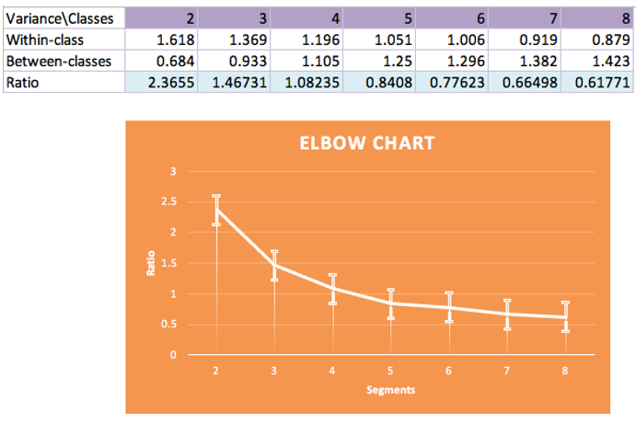
K-Means

Slide 10
How many customer segments can you estimate from the survey data? a. What are the profiles of the customer segments? b. Which customer segments should Sticks target?
Based on the K-means clustering and elbow plot, we estimated 3 customer segments. Below are the profiles of the customer segments
Segment 1: Female, Age between 26-40 with household income > 50K who make/eat lunch at home for 4 days a week or skip lunch 2 or more days a week.
Segment 2: Female, Age between 26-40 with household income >50K who prefers to buy lunch at restaurant 3 days a week or skip lunch for less than 2 days a week.
Segment 3: Female, Age between 26-40 with household income >50K who prefers to bring lunch to work at 3 days a week or skip lunch for less than 2 days a week.
Sticks should target customer segment 2 & 3 who prefers to eat out and less likely to skip lunch

Slide 11
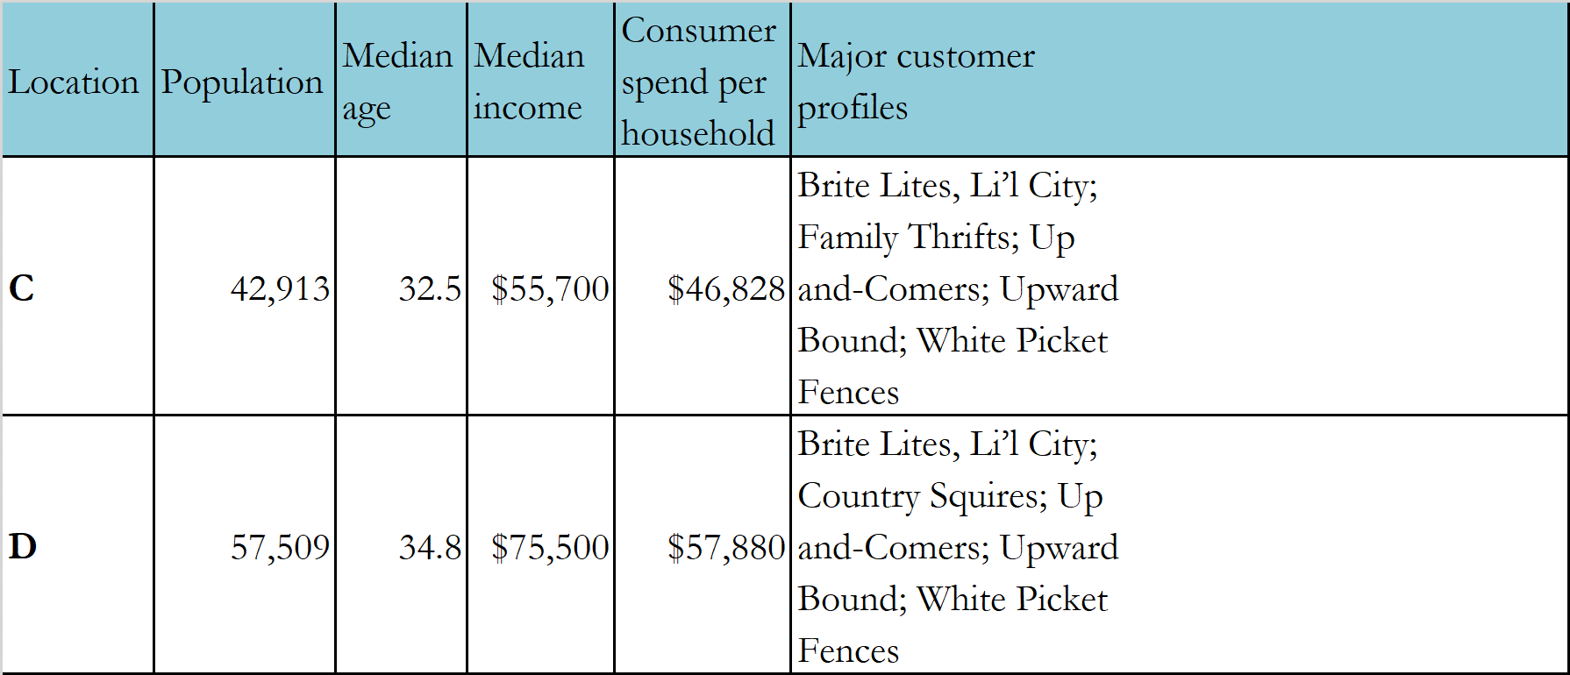
Provide a recommendation for the location of the next Sticks Kebob Shop based on the segmentation analysis and the demographic profiles of the locations
Based on the Customer segmentation analysis, it was determined that typical sticks customers are female between the age of 26 to 40 with an average household income between 50 to 100k.
Both Location C and D fits that criteria and also as the population of these location are relatively greater that the other 2 location, it improves the chance of sticks kabab being successful in these locations.
Notes:
12. Brite Lites, Li'l City – Not all of America's chic sophisticates live in major metros. Brite Lights, Li'l City is a group of well-off, middle-aged couples settled in the nation's satellite cities. Residents of these typical DINK (double income, no kids) households have college educations, well-paying business and professional careers, and swank homes filled with the latest technology. | Group C1 – 2nd City Society
34. White Picket Fences – Midpoint on the socioeconomic ladder, residents in White Picket Fences look a lot like the stereotypical American household of a generation ago: young, upper-middle-class, and married with children. But the current version is characterized by modest homes and ethnic diversity, including a large numbers of Hispanic and African-Americans households. | Group C2 – City Centers
24. Up-and-Comers – Up-and-Comers is a stopover for younger, upper-midscale singles before they marry, have families, and establish more deskbound lifestyles. Found in second-tier cities, these mobile adults, mostly age 25 to 44, include a disproportionate number of recent college graduates who are into athletic activities, the latest technology, and nightlife entertainment. | Group C2 – City Centers
63. Family Thrifts – The small-city cousins of inner-city districts, Family Thrifts contain young, ethnically diverse parents who have lots of children and work entry-level service jobs. In these apartment-filled neighborhoods, visitors find the streets jam-packed with babies and toddlers, tricycles and basketball hoops, Suzukis and Kias. | Group C3 – Micro-City Blues

Slide 12
Thank you

